Slide 1
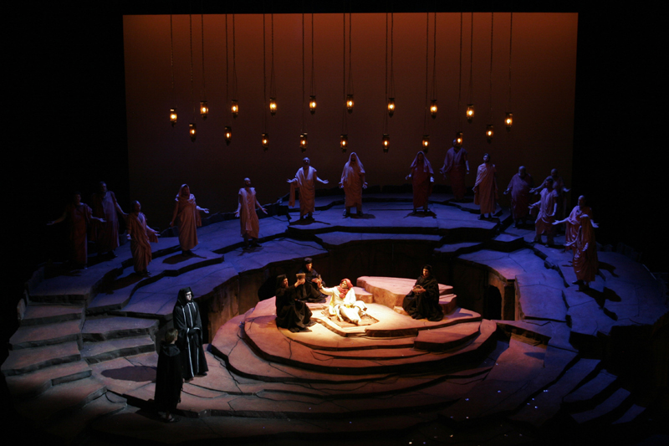
Introduction to Opera

Slide 2
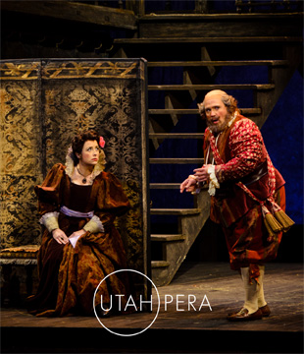
What Do You ALREADY Know?
Brainstorm a list of what you know or think you know about opera.
Do you know the names of any operas?
Has anyone in class ever been to an opera?
If so, which one(s)?
What did you like most about the opera experience?

Slide 3
What is opera?
An opera is like a play with singing added. Everybody sings almost all of the time.
Words, actions and music work together to tell a story full of conflict and emotion.
Opera started in Italy around the year 1600.
Opera singers train with teachers and coaches to learn how to sing over an orchestra without needing a microphone.
Audience members clap and even shout “Bravo!” when they have enjoyed a performance.

Slide 4
You May Have Heard OperA Music without knowing it….
1. Toreador Song from Bizet’s Carmen:
https://www.youtube.com/watch?v=-snRz5L3Ups
(sung in French by Dmitri Hvorotovsky, with English subtitles)
2. Queen of the Night from Mozart’s The Magic Flute:
https://www.youtube.com/watch?v=OLlux8ICOfI
(sung in German by Diana Damrau, with English subtitles)
Check out more famous opera scenes
at the end of this presentation.

Slide 5
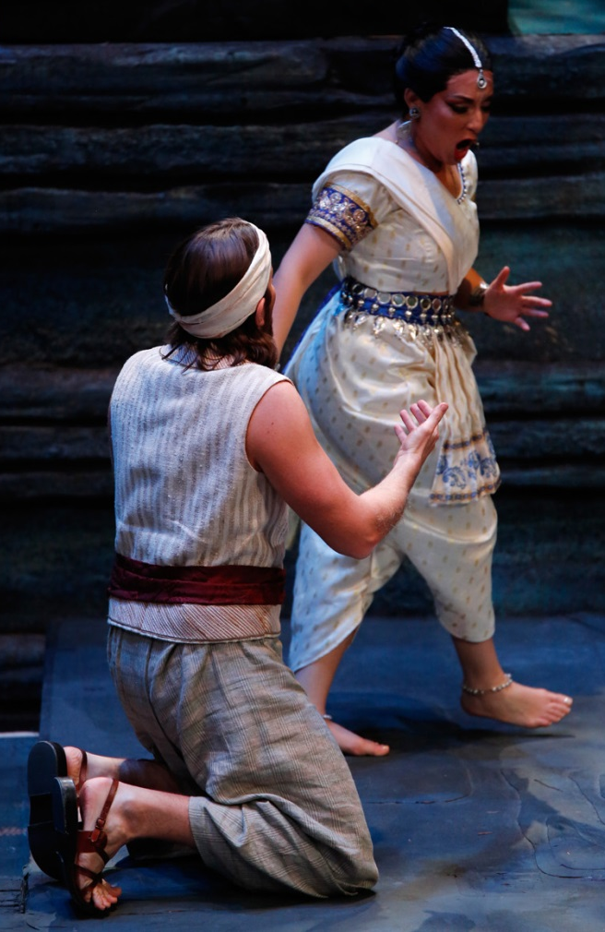
Operas and Languages
Operas are often sung in foreign languages because operas are written by composers from countries all over the world. Here are some examples:
Mozart wrote operas in Italian and German
Bizet wrote the opera Carmen in French
Puccini and Verdi wrote their operas in Italian
There are operas in Spanish, Russian, Czech, English and many others!
Music communicates easily so you can understand the feelings of an opera, even if you can’t understand the words.
At the Capitol Theatre, Utah Opera provides supertitles in English at all performances.

Slide 6
Opera Voice Types
Opera singers are identified by the quality, range (high to low), size and flexibility of their voices.
Most children have high voices and are sopranos. Voices change as you grow; your adult voice type depends on the size of your vocal cords – you sing and speak using the same mechanism.
Adult female voices (highest to lowest)
Soprano
Mezzo-Soprano
Alto
Adult male voices (highest to lowest)
Tenor
Baritone
Bass

Slide 7
Meet Utah Opera’s Performers for school PROGRAMS 2018-19

Slide 8
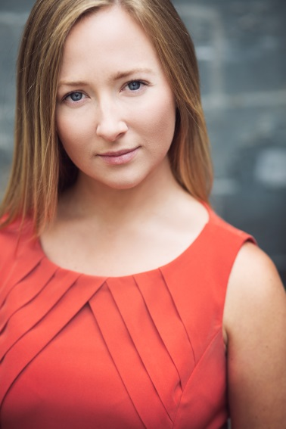
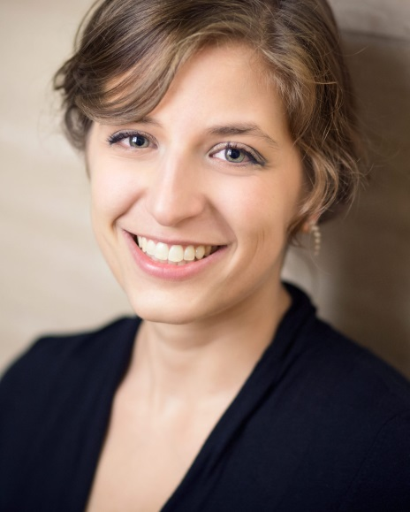
Utah Opera’s Resident Artists
Soprano Grace Kahl
from New York
likes podcasts
Mezzo-Soprano Melanie Ashkar
from Virginia
likes board games

Slide 9
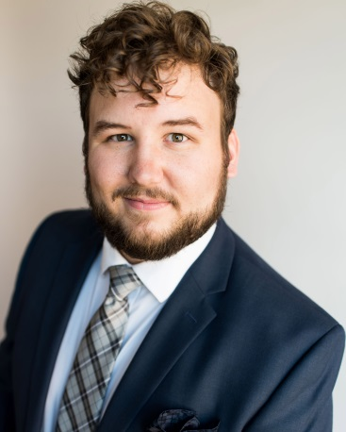
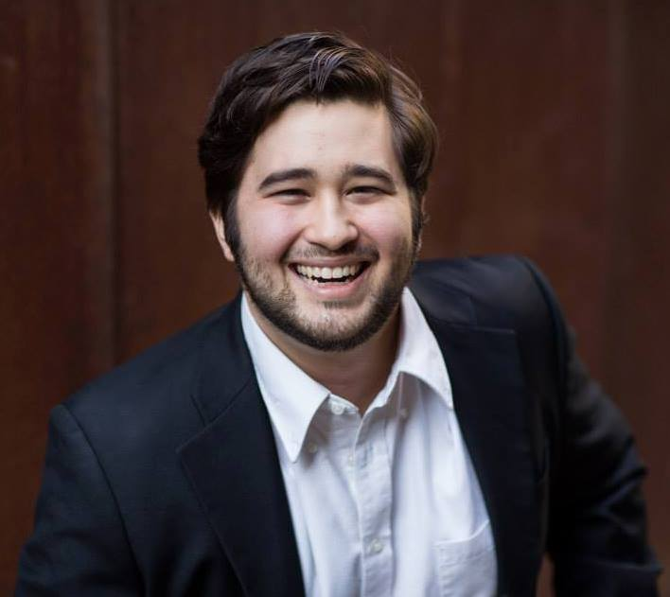
Tenor Addison Marlor
from Utah
likes camping
Baritone Jesús Murillo
from Michigan
likes painting

Slide 10
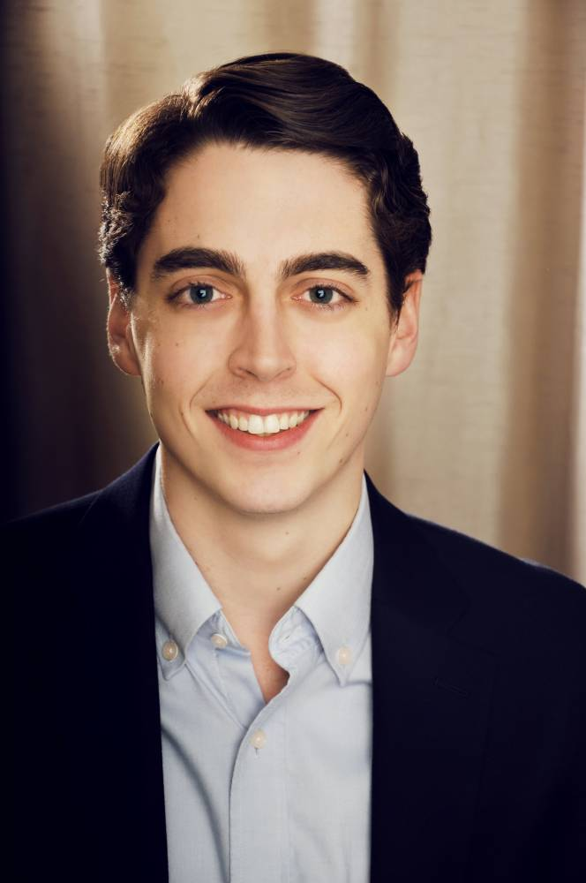
And playing the role of the orchestra….
Pianist Robert Bosworth
from Texas
likes reading

Slide 11
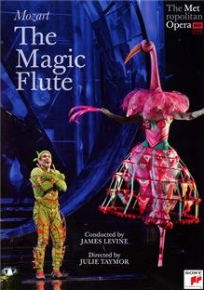
AFTER THE PERFORMANCE:
Our Resident Artists will give your school
a DVD recording of Mozart’s opera The Magic
Flute for your school library. It’s a
fantastic production by The Metropolitan
Opera in New York City of one of the world’s
favorite operas. If we have not already donated a copy of The Magic Flute to your school, our artists will do that at the end of the presentation. We hope your class will
watch it together and enjoy paying attention
to everything you’ve learned about opera.
Check out additional resources for watching the Magic Flute on our website.
Additionally there are great videos of The Little Prince (also in our season) on YouTube.

Slide 12
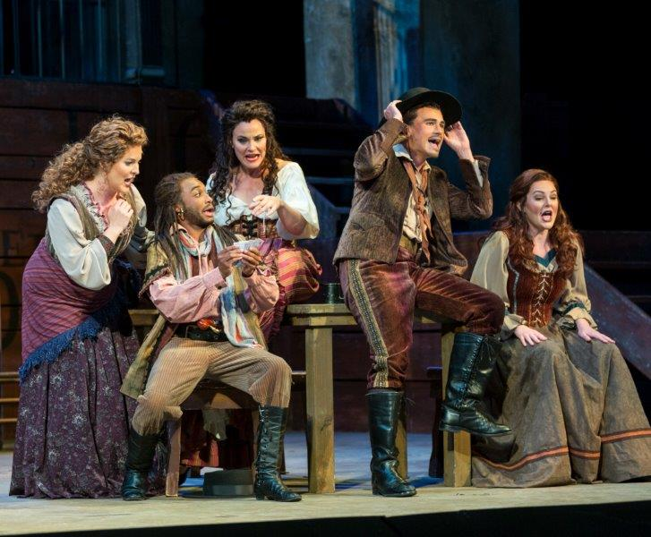
Opera-tunity Nights:
Utah Opera invites secondary school students to final dress rehearsals of operas in the Capitol Theatre. Tickets are free for public school students and $5 for homeschool and private school students. Check online for schedule and other student discounts, as well as info about High School Music Clubs.
Link to our website for Opera-tunity night and High School Music Clubs!

Slide 13
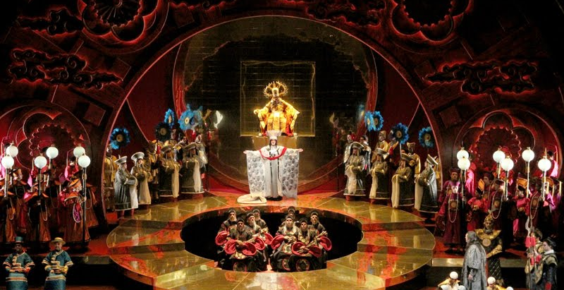
ADDitional links to opera
the famous overture to Rossini’s opera The Barber of Seville (orchestra music before the opera begins):
https://www.youtube.com/watch?v=DiNFVb-TxL4
well-known aria (solo) from Mozart’s The Marriage of Figaro:
https://www.youtube.com/watch?v=e1-FKyOTvto
tenor aria ‘Nessun dorma’ from Puccini’s Turandot:
https://www.youtube.com/watch?v=aNQeKvVPPlc (3 tenors in concert)

Slide 14
Enjoy your opera experience with…

